Slide 1
Agile Intro – Part II

Slide 2
Content
Sprint planning
Refinement
Spikes
Sprint velocity
Sprint goal
Sprint review
Sprint retrospective

Slide 3
Refinement
Before an item can be added to a sprint, it must be in a “ready” state: refined and estimated
Refinement of product backlog item(s) usually happens in separate meetings, before planning
During refinement we clarify what needs to be done and how (with the goal of being able to plan it)
During planning we only focus on the planning
Notes:
https://www.scrum.org/resources/blog/product-backlog-refinement-explained-13
Refinement can be done individually or with a smaller group of people to save time in the planning session itself.

Slide 4

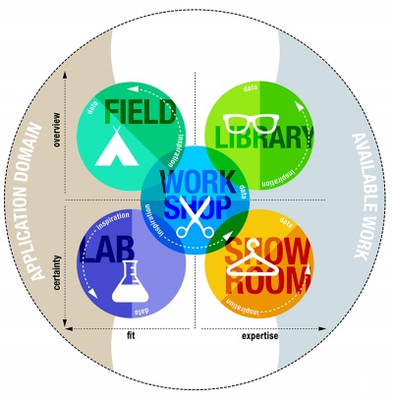
Spikes
Uncertainty is part of software development
Sometimes there is a lot of uncertainty
Which technology to use?
Which data source to use?
How could integration with another system work?
Introducing: The spike
Time-boxed. Keep it short!
Related to research
Notes:
https://www.growingscrummasters.com/deploy-improve-scrum/what-is-a-spike/
The spike is a product backlog item used when there is a lot of uncertainty. It is typically used when we need to do a considerable amount of work before we can even estimate or plan a new user story.
The only goal of the spike is to reduce the uncertainty, not to implement the functionality already! So keep it short.
Typically these are related to research methods in the DOT framework.

Slide 5
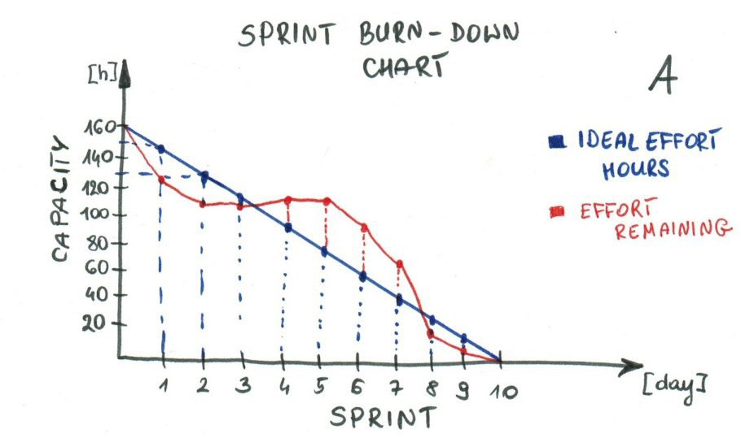
Sprint Velocity
You did planning poker last sprint
How do we know how many story points we can do in the next sprint?
Measure sprint velocity!
Use burn-down charts
to keep track during the
sprint
Notes:
Jira| Story Point vs Hours estimation:
https://www.youtube.com/watch?v=QUo5l4wwmzk
Velocity using Jira:
https://www.youtube.com/watch?v=goMqlVkxrcw

Slide 6
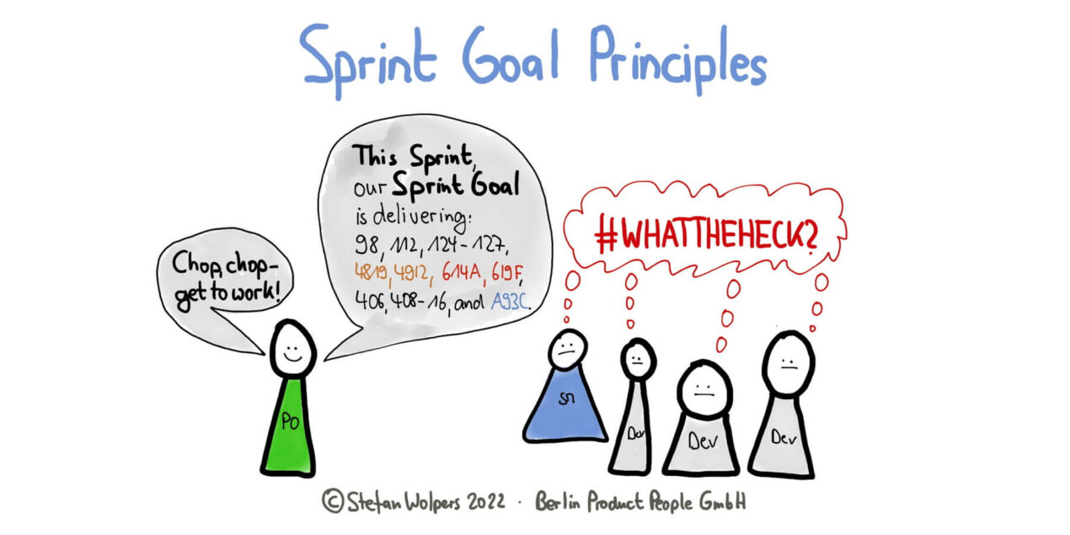
Sprint goal
As software engineers we tend to focus on separate tasks
Add a sprint goal! This is the goal we are trying to achieve
Should be related to product increment, what do you want to show in the review?
Purpose of stand-up is to check we are on track regarding the sprint goal!
Notes:
https://age-of-product.com/sprint-goal-principles/
Image source: https://age-of-product.com/sprint-goal-principles/

Slide 7
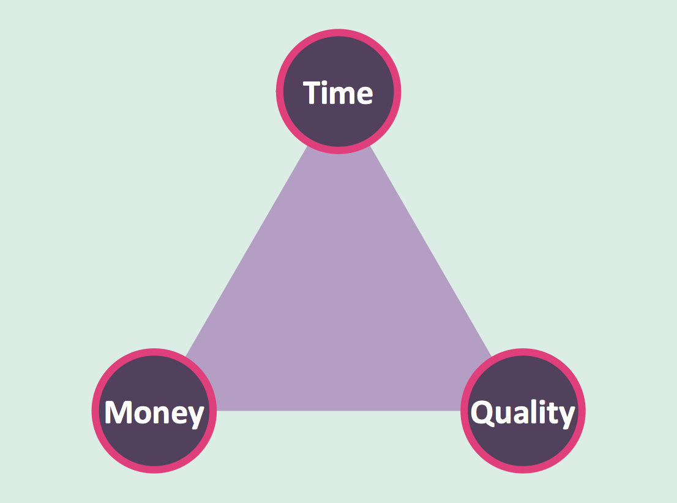
Tradeoff quality/time/money
Typically we want
High quality
Fast
Cheap
You need to choose 2 of those!
Notes:
Image source: https://www.conceptdraw.com/How-To-Guide/time-quality-money-triangle-diagram
Typically clients want to have it all: high quality products, as fast as possible, as cheap as possible. However, these three are a tradeoff.
Fast + High Quality = Expensive
Fast + Cheap = Low quality
Cheap + High Quality = Slow

Slide 8
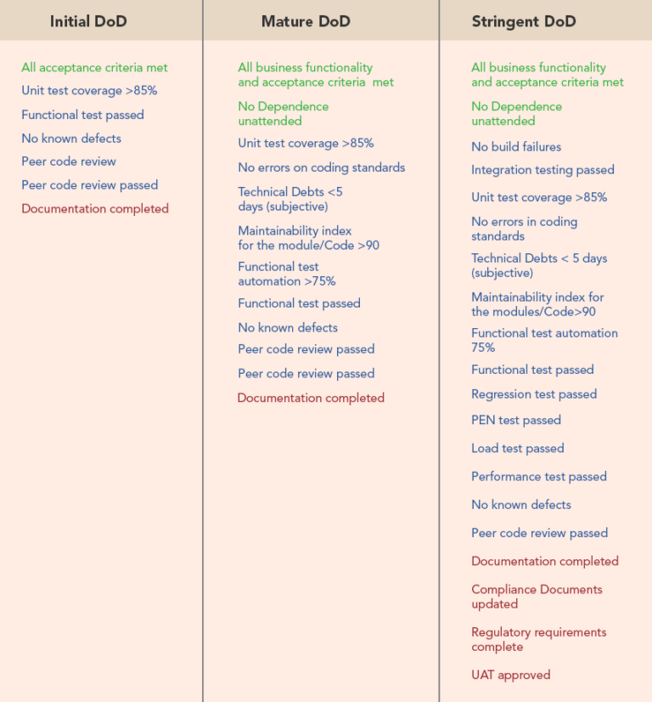
Definition of Done
When is a product
backlog item done?
Depends on context
and project phase
Notes:
https://www.scrum.org/resources/blog/done-understanding-definition-done Definition of Done (DoD) vs Definition of Ready (DoR) in Jira:
https://www.youtube.com/watch?v=jKheJvgMyfI

Slide 9
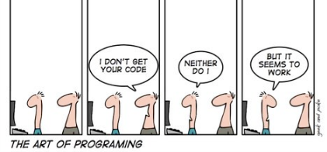
Code Reviews
Code reviews help to:
Sharing knowledge about the code base
Discover bugs earlier
Maintain coding style and standards
Improve code quality
Increase collaboration
Notes:
Code reviews are almost always part of Definition of Done. Many tools support code cannot be merged to master/main without at least one code review.

Slide 10
Sprint Review – Part 1
Be transparent!
Goal is to get feedback from your stakeholders
Only show items that are Done (by Definition of Done)
Notes:
https://www.scrum.org/resources/what-is-a-sprint-review
Only show items that are actually done to prevent setting too high expectations. You will have to make up for the time in the next sprint!
How did the group do in the last sprint review? Were there any things that co

Slide 11
Sprint Review – Part 2
Structure:
Summarize what has been done in current sprint.
User stories and Definition of Done (DOD) of current sprint.
Demonstrate / show the system – prototype (if necessary).
User Stories and Acceptance Criteria of next sprint.
Burndown Chart.
Open-ended questions.
Notes:
Tip: Work on the most important task/user stories – i.e. Burndown chart will be used to negotiate the total number of user stories for next sprint.
Burndown Chart:
https://en.wikipedia.org/wiki/Burndown_chart/

Slide 12
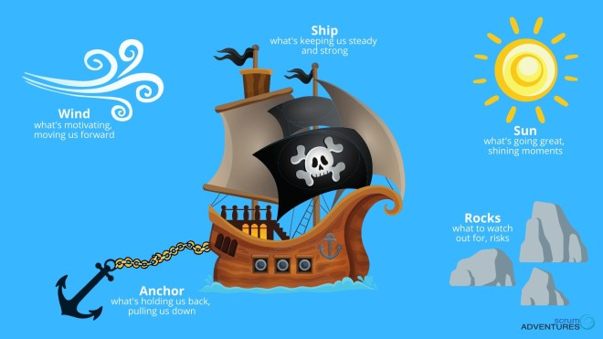
Retrospective formats
What format did you use last retrospective?
Sometimes a different viewpoint can help
Many different formats available!
Start/stop/continue
Mad/sad/glad
Pirate ship
…
Notes:
https://easyretro.io/retrospective-ideas/
Image source: https://scrumadventures.com/retrospectives/

Slide 13
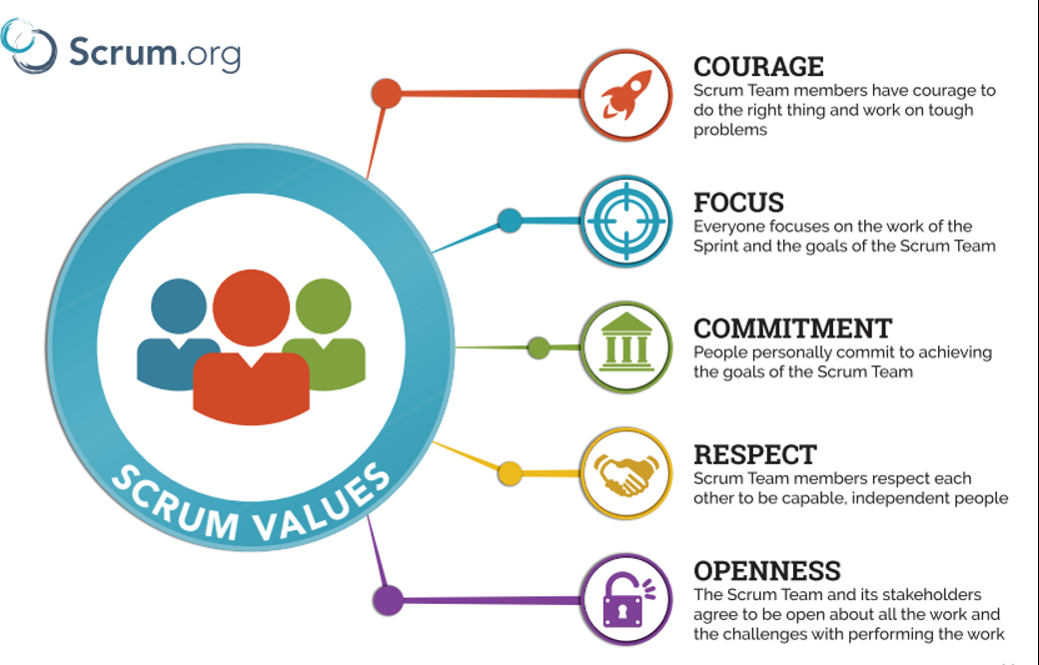
Scrum values
Notes:
Image source: Https://scrumorg-website-prod.s3.amazonaws.com/drupal/2018-05/ScrumValues-Tabloid.pdf
These are the five values of scrum. How is your team doing with regard to each of those?
You can consider doing a “scrum values retrospective”. See https://www.teamretro.com/retrospectives/scrum-values-retrospective for more details.
From the scrum guide (https://scrumguides.org/scrum-guide.html):
The Scrum Team commits to achieving its goals and to supporting each other. Their primary focus is on the work of the Sprint to make the best possible progress toward these goals. The Scrum Team and its stakeholders are open about the work and the challenges. Scrum Team members respect each other to be capable, independent people, and are respected as such by the people with whom they work. The Scrum Team members have the courage to do the right thing, to work on tough problems.
These values give direction to the Scrum Team with regard to their work, actions, and behavior. The decisions that are made, the steps taken, and the way Scrum is used should reinforce these values, not diminish or undermine them. The Scrum Team members learn and explore the values as they work with the Scrum events and artifacts. When these values are embodied by the Scrum Team and the people they work with, the empirical Scrum pillars of transparency, inspection, and adaptation come to life building trust.

Slide 14

Questions?

Slide 15
References & extra material
References & further reading
Agile Manifesto, 4 values and 12 principles, http://www.agilemanifesto.org
Scrum Guide, http://scrumguides.org
Scrum values, https://www.scrumalliance.org/why-scrum/core-scrum-values-roles
Scrum(software development), https://en.wikipedia.org/wiki/Scrum_(software_development)
Scrum daily meetings, https://www.quickscrum.com/Article/ArticleDetails/4045/1/Scrum-Daily-Meeting
How to develop a backlog, https://www.lucidchart.com/blog/how-to-develop-a-product-backlog-in-agile
Burn-down charts, https://stxnext.com/blog/2018/07/26/all-about-burn-down-charts/
Scrum tutorial, https://www.tutorialspoint.com/scrum/index.htm
User stories, https://www.romanpichler.com/blog/10-tips-writing-good-user-stories/
Scrum Artifacts, https://www.scrumalliance.org/about-scrum/artifacts
Definition of done, https://www.scrum.org/resources/blog/done-understanding-definition-done
Acknowledgements:
Jeff Sutherland’s 59 minute scrum https://www.valueflowquality.com/wp-content/uploads/2014/08/Scrum-Activity-3-The-59-Minute-Scrum.pdf
Notes:
Fibonacci agile: https://www.productplan.com/glossary/fibonacci-agile-estimation/
Jira| Story Point vs Hours estimation, https://www.youtube.com/watch?v=QUo5l4wwmzk
Velocity using Jira, https://www.youtube.com/watch?v=goMqlVkxrcw
Definition of Done (DoD) vs Definition of Ready (DoR) in Jira: https://www.youtube.com/watch?v=jKheJvgMyfI
Burndown Chart, https://en.wikipedia.org/wiki/Burndown_chart/

